Slide 1


PROJECT GUI PYTHON
Wiryanata Sunardi (2006574295)
Evelio Excellenta (2006579705)
Vincentius Adrian Abimanyu WS (2006466366)

Slide 2


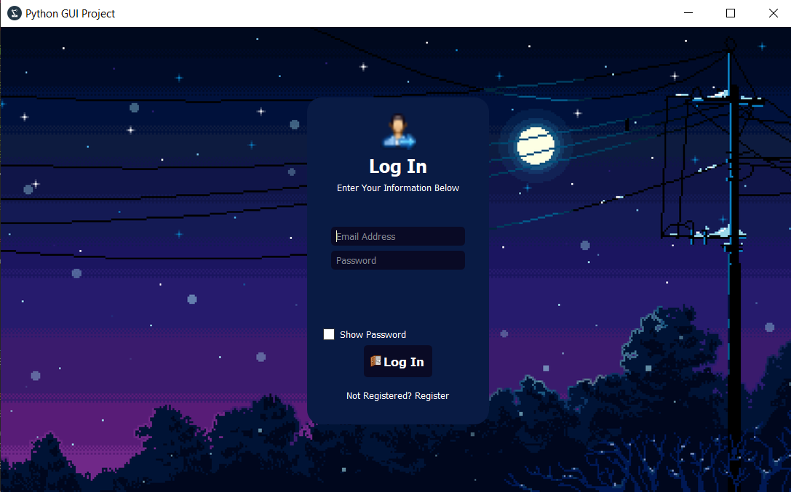
Login Page
Show Password Feature
Online Database using Firebase
Email-based authentication
Sign Up Feature

Slide 3
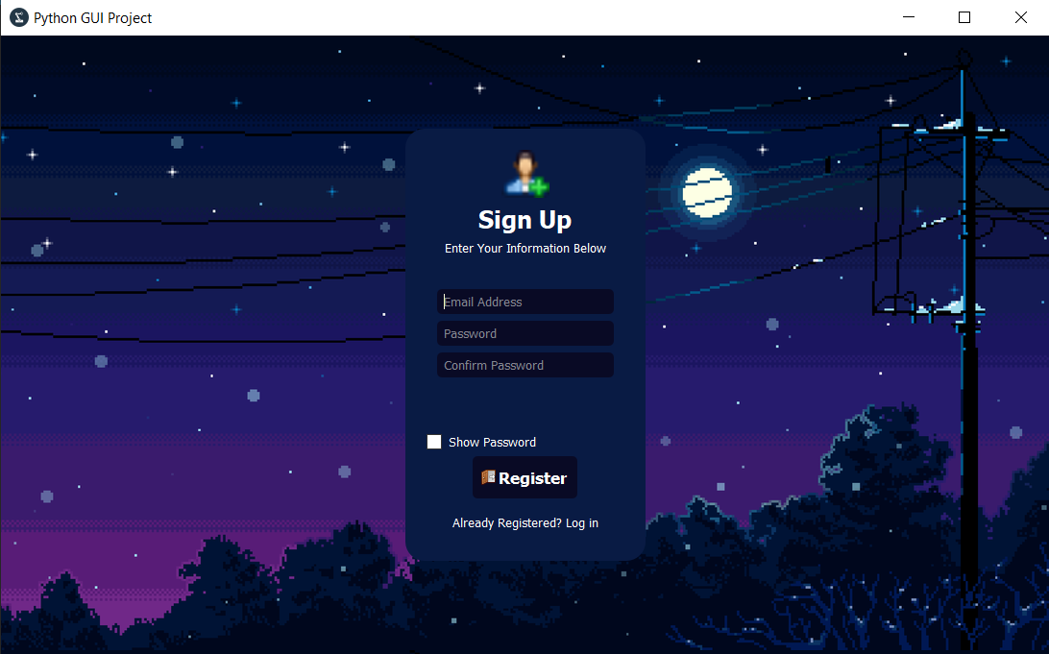
Sign Up Page
Show Password Feature
Sign Up Notification
Confirmation Password feature
Safe Hosting

Slide 4
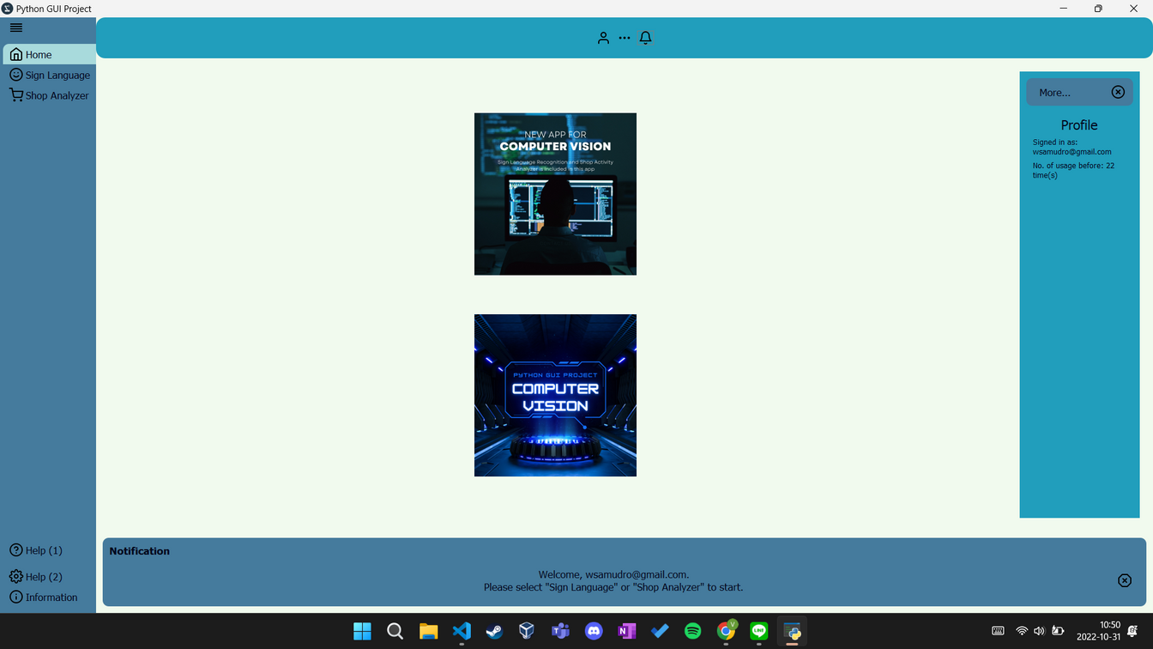

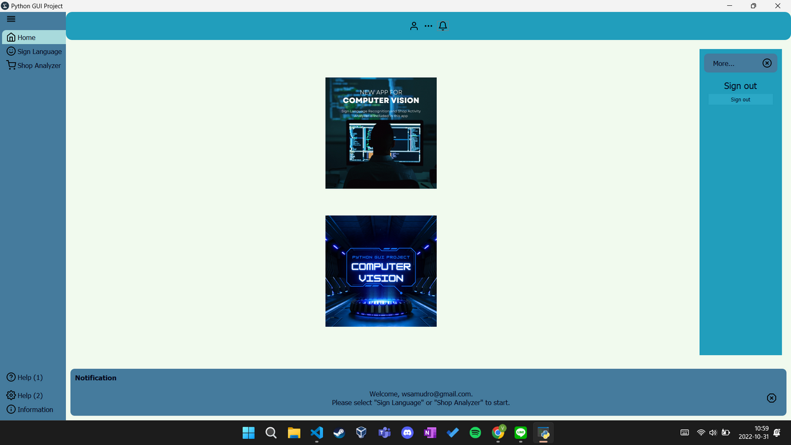
Profile
Show account information
Show number of usage
Allow user to sign out

Slide 5
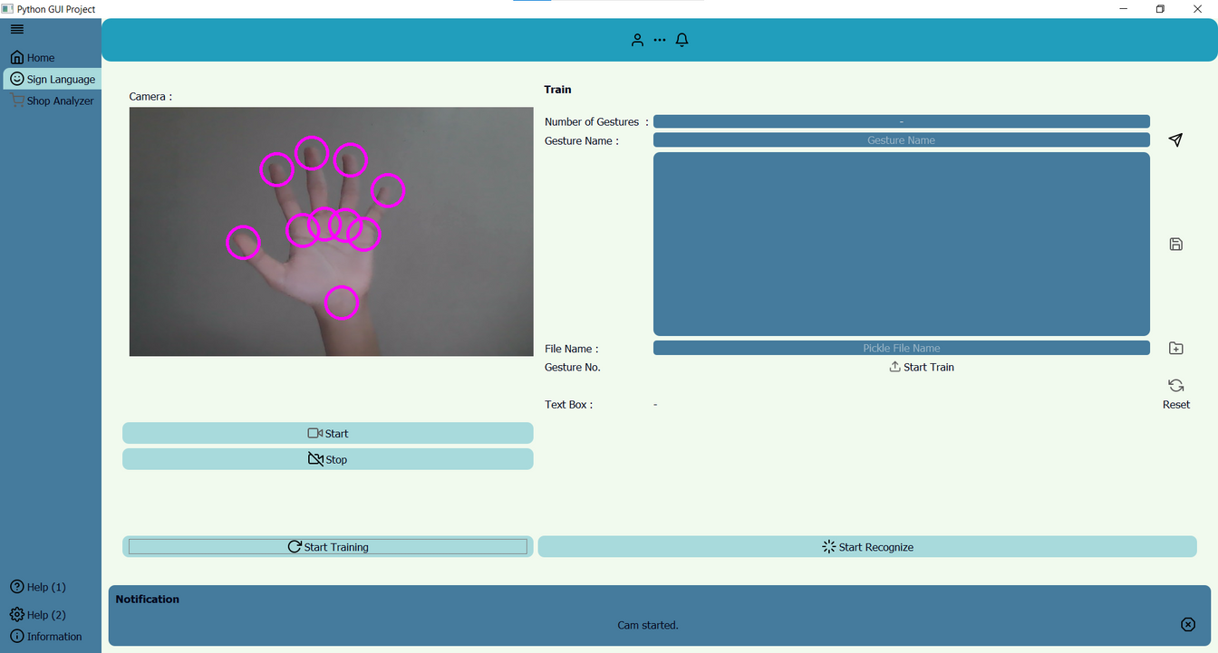
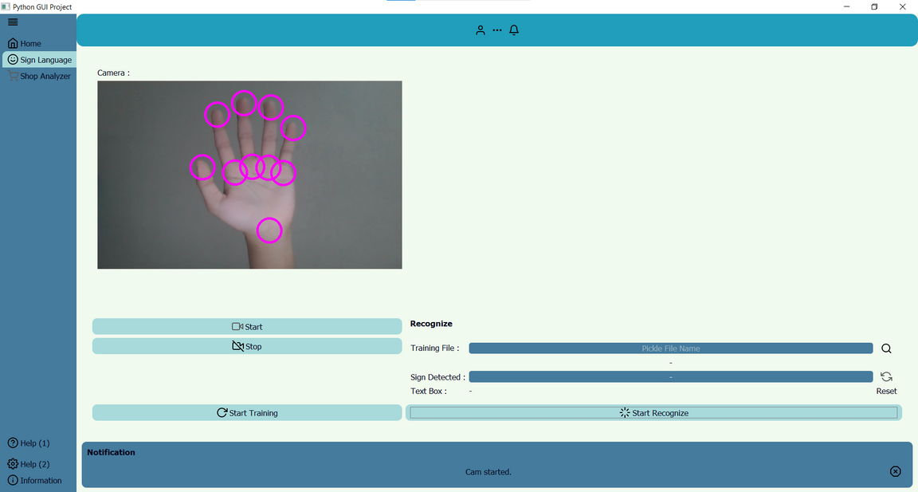
Sign Language
Hand detection camera
Locally Write & Read .pkl file
Train sign language
Recognize using saved sign language
Text Box of detected words

Slide 6
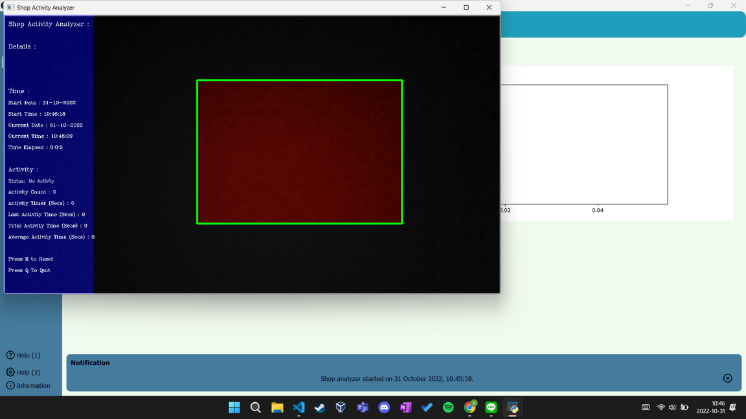
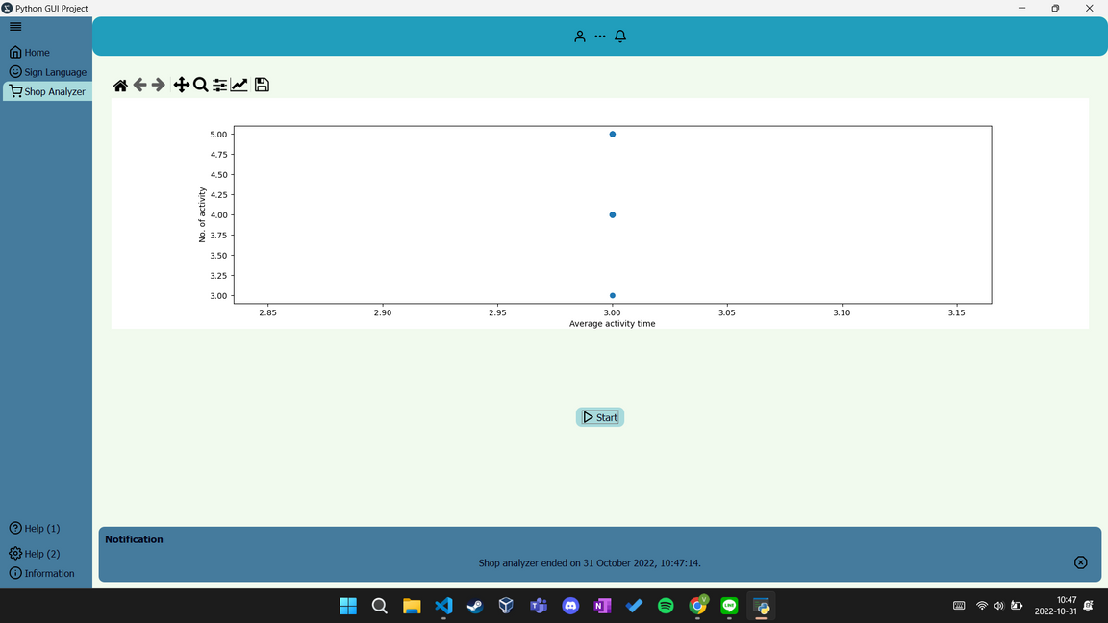
Shop Analyzer
Graph for plotting
Notification/prompt for user
Activity log saved in database

Slide 7
Thank You
BY GROUP 5

